Slide 1
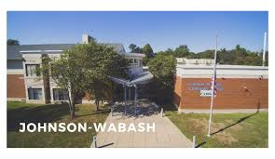
Johnson Wabash
6th Grade Center
Orientation Presentation

Slide 2
Agenda
Introductions
Expectations
Schedule
AVID
Meet & Greet

Slide 3
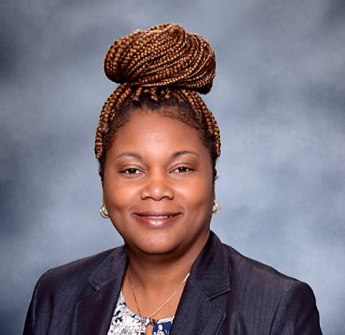
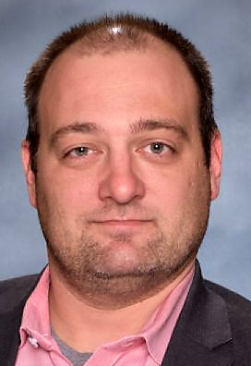
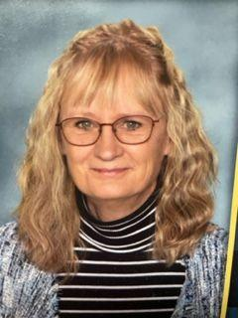
Introductions
Principal
Assistant Principal
Counselor
Ms. Francwar
Dr. Eye
Mrs. Kasmarzik

Slide 4
Student Expectations
Junior Comets have high expectations and they aim to exceed them each and every day.
Junior Comets take school seriously.
Arrive to school and class on time.
Participate in class and take responsibility for your learning.
Do all of our work on time and to the best of your ability.
Be organized and ready to begin learning and continue learning each day.
Stick to a task and persevere, even when it seems too challenging.
Keep your cell phones out of sight.

Slide 5
Student Expectations
Junior Comets have high expectations and they aim to exceed them each and every day.
Junior Comets take pride in ourselves.
Speak respectfully when responding.
Keep your hats and hoods off in the classroom.
Walk with a purpose in the hallways. Your goal is to make it to the next class on time.
We respond appropriately to reasonable requests.
We wear ID’s at all times.

Slide 6
Parent Expectations
Ensure students arrive to school on time at 7:25 a.m.
All students must arrive with a chromebook that is fully charged (Students can’t complete work without their chromebook.)
Report all absences to our office staff.
If your student is absent, be sure to remind them to access their work within Canvas. Each teacher has a Canvas page that is updated weekly with class assignments.
Build relationships with teachers, help us to get to know your child and their academic needs.
Check grades often within Tyler. Use your log-in to access the Tyler parent portal.
Purchase a clear backpack for your child before the start of school.
Talk to your child about the expectation that cell phones should be out of sight during school hours (backpack, hoodie pocket, etc.)

Slide 7
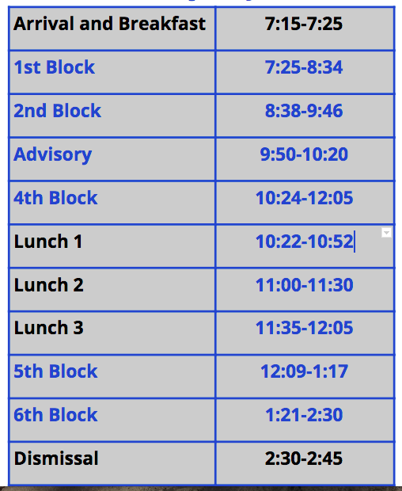
Schedule
Students will travel from
class to class. Each “passing
time” is 3 minutes.
Team classes are all close in proximity so students will have only a short distance to travel.
At JW- we follow an A/B block schedule. This means that 2 days a week they will have one elective class and 2 days a week they will have the other. The 5th day will rotate from an A day to a B day.

Slide 8
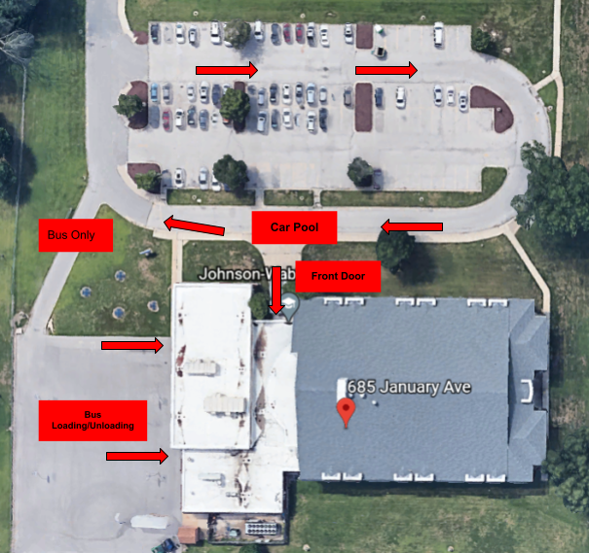
Students are allowed to enter the building at 7:10 am.
Breakfast will be available in the cafe, gym, and common area.
Students will grab breakfast and go to first hour- moving quickly through the breakfast line.
Students will be directed to their first hour class.

Slide 9
Teams
Johnson Wabash 6th Grade Center is a middle school. This means that we use the team approach. Students are grouped into one of 4 teams of about 80 students. For most students, this means they will travel amongst the same 4 core teachers.

Slide 10
Core Classes Descriptions
(Access this presentation on the school website)
Math
ELA
Science
Social Studies

Slide 11
Elective Descriptions
Elective Descriptions

Slide 12
Advisory Description
Advisory is a 30 minute class period each day where students have time to connect with teachers in a smaller group setting. Students will...
Learn how to be organized
Explore opportunities for college and careers
Learn to check their grades and attendance on Tyler
Set goals for success in grades and attendance
Learn techniques that help balance the social-emotional issues of being a pre-teen
Learn self-care strategies
Learn how to be a good citizen of their school, neighborhood, city, state, country, world, and Earth

Slide 13
AVID Description
AVID is a district program designed to prepare students for college and career readiness.
The acronym of AVID stands for Advancement Via Individual Determination
Every middle school and high school in the district participates in AVID.
In 6th grade, we focus on developing determination by teaching students to set goals, get organized, and practice collaboration.
When students get to Ferguson Middle School, they will continue using collaboration and organizational skills and start focusing more on note taking and writing.
In high school there will be a heavy emphasis on taking challenging classes, preparing for college entrance exams, and getting into college or starting a career.
AVID
AVID

Slide 14
TOP Description
TOP

Slide 15
“Every child deserves a champion-an adult who will never give up on them,
who understands the power of connection, and insists that they become the
best that they can possibly be.”-Rita Pierson

Slide 16
Building Tour
Meet & Greet (all JW staff and teachers)
Collect a syllabus for each subject area (ELA, math, science, SS, and electives)
Ask us questions

